Slide 1
Topics
Big data platforms
Map-Reduce
Distributed File Systems

Slide 2

Map-Reduce and the New Software Stack
Slides from: http://www.mmds.org
Mining of Massive Datasets
Jure Leskovec, Anand Rajaraman, Jeff Ullman Stanford University
http://www.mmds.org

Slide 3
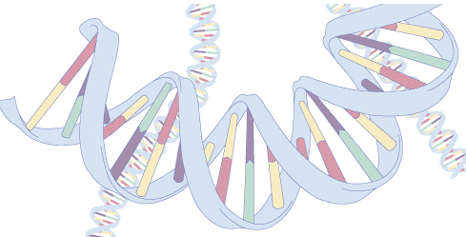
DNA and Codons

Slide 4
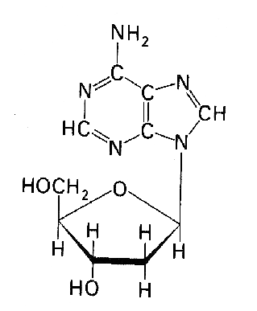
DNA (Deoxyribo Nucleic Acid)
DNA is a polymer of nucleotide monomers
2’-deoxyribose sugar
Four bases:
Adenine, A
Guanine, G
Thymine, T
Cytosine, C

Slide 5
The Genetic Code
Describes how base sequences are converted to protein sequence
DNA sequence is divided into series of units of three bases → a codon
One codon is specific to one amino acid ( structural component of protein)

Slide 6
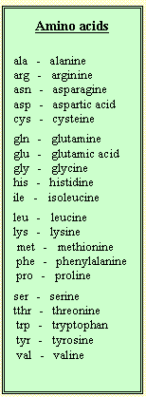
The Genetic Code
The four bases can form 64 codons
20 amino acids are found in nature

Slide 7
The human genome
The Human genome...
3 billion base pairs
about 30,000 genes
23 chromosome pares → 46 chromosomes
25% of the DNA is gene related
Only 5% encodes proteins
Genes include exons and introns
Beside coding areas also additional secuences are found

Slide 8
A computing problem
The Human genome...
Human genome has 3 billion base pairs
What is the distribution of codons in the human genome?
Data:
3 billion long sequence of base pairs from each subject
From 333 humans
= 1,000 billion base pairs

Slide 9
Our computer
The Human genome...
Disk:
1 TB = 10¹² bytes
Read speed of 100 MB/s
CPU:
Quad core 2.5 GHz

Slide 10
Single Node Architecture
CPU
Data sets that fit in memory
Memory
Larger data sets
Disk

Slide 11
Motivation: Google Example
20+ billion web pages x 20KB = 400+ TB
1 computer reads 30-35 MB/sec from disk
~4 months to read the web
~1,000 hard drives to store the web
Takes even more to do something useful with the data!

Slide 12
Solution: Distributed Computing
Spread the work over many machines
Good news: same problem with 1000 machines, < 3 hours
Bad news: Distributed computing is hard!
communication and coordination
recovering from machine failure
optimization
Data locality

Slide 13
Clusters of computers
Today, a standard architecture for such problems is emerging:
Cluster of commodity Linux nodes
Commodity network (ethernet) to connect them

Slide 14
Cluster Architecture
2-10 Gbps backbone between racks
1 Gbps between
any pair of nodes
in a rack
Switch
Switch
Switch
CPU
CPU
CPU
CPU
Mem
…
Mem
Mem
…
Mem
Disk
Disk
Disk
Disk
Each rack contains 16-64 nodes
In 2011 it was guestimated that Google had 1M machines, http://bit.ly/Shh0RO

Slide 15
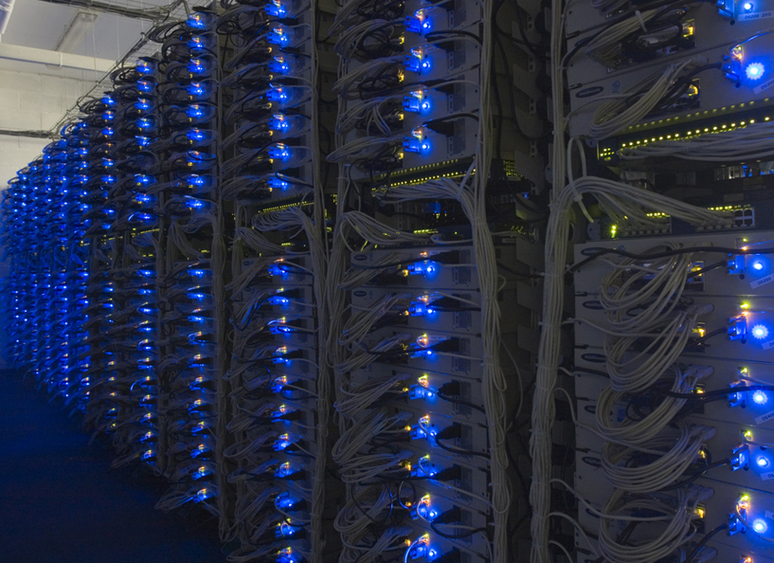

Slide 16
Large-scale Computing
Large-scale computing for data mining problems on commodity hardware
Challenges:
How do you distribute computation?
How can we make it easy to write distributed programs?
Machines fail:
One server may stay up 3 years (1,000 days)
If you have 1,000 servers, expect to lose 1/day
People estimated Google had ~1M machines in 2011
1,000 machines fail every day!

Slide 17
Idea and Solution
Issue: Copying data over a network takes time
Two key ideas:
Store files multiple times for reliability
Bring computation close to the data
Map-reduce addresses these problems
Google’s computational/data manipulation model
Elegant way to work with big data
Storage Infrastructure – File system
Google: GFS. Hadoop: HDFS
Programming model
Map-Reduce

Slide 18
Storage Infrastructure
Problem:
If nodes fail, how to store data persistently?
Answer:
Distributed File System:
Provides global file namespace
Google GFS; Hadoop HDFS;
Typical usage pattern
Huge files (100s of GB to TB)
Data is rarely updated in place
Reads and appends are common

Slide 19
File formats and file systems
Memory (RAM)
Random access
Disk
HDD, SSD
Block access
File
Unit of organizing data on disk
File format
How to arrange “random” data in sequential format?
E.g. row-based (.xls, .csv)
Column-based (Parquet)
File system
How are files arranged on disk?
CPU
Memory
Disk

Slide 20
Distributed File System
Chunk servers
File is split into contiguous chunks
Typically each chunk is 16-64MB
Each chunk replicated (usually 2x or 3x)
Try to keep replicas in different racks
Master node
a.k.a. Name Node in Hadoop’s HDFS
Stores metadata about where files are stored
Might be replicated
Client library for file access
Talks to master to find chunk servers
Connects directly to chunk servers to access data

Slide 21
Distributed File System
Reliable distributed file system
Data kept in “chunks” spread across machines
Each chunk replicated on different machines
Seamless recovery from disk or machine failure
C₀
C₁
D₀
C₁
C₂
C₅
C₀
C₅
…
C₅
Chunk server 1
C₂
C₅
Chunk server 2
C₃
D₀
Chunk server 3
D₁
D₀
Chunk server N
C₂
Bring computation directly to the data!
Chunk servers also serve as compute servers
Notes:
21

Slide 22
MapReduce
Challenges:
How to distribute computation?
Distributed/parallel programming is hard
Map-reduce addresses all of the above
Google’s computational/data manipulation model
Elegant way to work with big data

Slide 23
How can we make it easy to write distributed programs?
MapReduce
A simple programming model that applies to many large-scale computing problems
Hide messy details in MapReduce runtime library:
automatic parallelization
load balancing
network and disk transfer optimization
handling of machine failures
improvements to core library benefit all users of library!

Slide 24
How can we make it easy to write distributed programs?
MapReduce
Developed at Google but not available outside the company
Open source version: Apache Hadoop
A big part of the Big Data technology landscape
Part of the Big Data “software stack”

Slide 25
MapReduce: Overview
Sequentially read a lot of data
Map:
Extract something you care about
Group by key: Sort and Shuffle
Reduce:
Aggregate, summarize, filter or transform
Write the result
Outline stays the same, Map and Reduce change to fit the problem

Slide 26
More Specifically
Input: a set of key-value pairs
Programmer specifies two methods:
Map(k, v) → <k’, v’>*
Takes a key-value pair and outputs a set of key-value pairs
E.g., key is the filename, value is a single line in the file
There is one Map call for every (k,v) pair
Reduce(k’, <v’>*) → <k’, v’’>*
All values v’ with same key k’ are reduced together and processed in v’ order
There is one Reduce function call per unique key k’

Slide 27
MapReduce: The Map Step
Input
key-value pairs
Intermediate
key-value pairs
k
v
map
k
v
k
v
map
k
v
k
v
…
…
k
v
k
v

Slide 28
MapReduce: The Reduce Step
Output
key-value pairs
Intermediate
key-value pairs
Key-value groups
reduce
k
v
k
v
v
v
k
v
Group
by key
reduce
k
v
k
v
v
k
v
k
v
…
…
…
k
v
k
v
k
v

Slide 29
Map-Reduce: Environment
Map-Reduce environment takes care of:
Partitioning the input data
Scheduling the program’s execution across a set of machines
Performing the group by key step
Handling machine failures
Managing required inter-machine communication

Slide 30
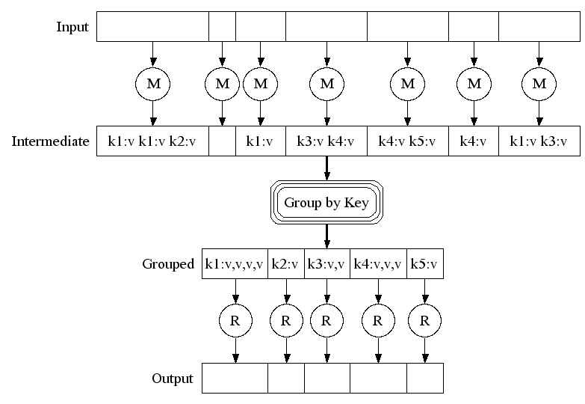
Map-Reduce: A diagram
Big document
MAP:
Read input and produces a set of key-value pairs
Group by key:
Collect all pairs with same key
(Hash merge, Shuffle, Sort, Partition)
Reduce:
Collect all values belonging to the key and output

Slide 31
Data Flow
Input and final output are stored on a distributed file system (FS):
Scheduler tries to schedule map tasks “close” to physical storage location of input data
Intermediate results are stored on local FS of Map and Reduce workers
Output is often input to another MapReduce task

Slide 32
Coordination: Master
Master node takes care of coordination:
Task status: (idle, in-progress, completed)
Idle tasks get scheduled as workers become available
When a map task completes, it sends the master the location and sizes of its R intermediate files, one for each reducer
Master pushes this info to reducers
Master pings workers periodically to detect failures

Slide 33
Dealing with Failures
Map worker failure
Map tasks completed or in-progress at worker are reset to idle
Reduce workers are notified when task is rescheduled on another worker
Reduce worker failure
Only in-progress tasks are reset to idle
Reduce task is restarted
Master failure
MapReduce task is aborted and client is notified

Slide 34
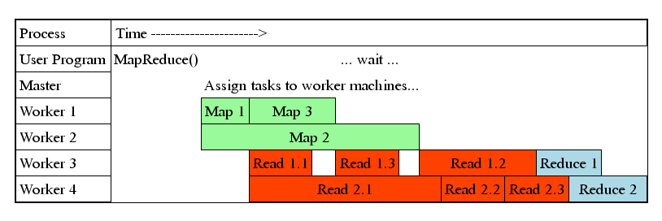
Task Granularity & Pipelining
Fine granularity tasks: map tasks >> machines
Minimizes time for fault recovery
Can do pipeline shuffling with map execution
Better dynamic load balancing

Slide 35
MapReduce Features
Many Map and Reduce tasks
Improved load balancing
Automatic re-execution on failure
In a large cluster, some nodes are always slow or flaky
Framework re-executes failed tasks
Locality optimizations
With large data, bandwidth to data is a problem
Map tasks are scheduled close to the inputs when possible

Slide 36
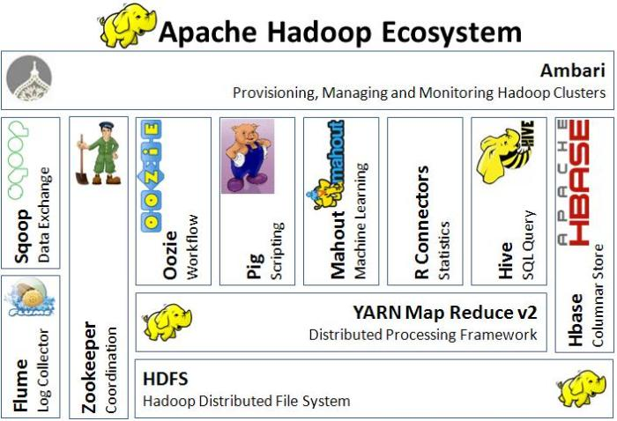

Slide 37
Problems Suited for Map-Reduce

Slide 38
Example: Generating Language Model Statistics
Given a large number of documents
count # of times every 5-word sequence occurs
and keep all those where count >= 4
with MapReduce:
map : extract 5-word sequences => count from document
reduce : combine counts, and keep if count large enough
https://research.googleblog.com/2006/08/all-our-n-gram-are-belong-to-you.html

Slide 39
Programming Model: MapReduce
Warm-up task:
We have a huge text document
Count the number of times each distinct word appears in the file
Sample application:
Analyze web server logs to find popular URLs

Slide 40
Example: Word Frequencies in Web Pages
A typical exercise for a new Big Data engineer in his or her first week
Input is a set of text files
Output: a count of every unique word
Example input:
“Deer bear river”
“Car car river”
“Deer car bear”
Output:
Deer: 2
Bear: 2
River: 2
Car: 3

Slide 41
MapReduce solution: map()
Specify a map function that takes a key/value pair
key = document name; value = document contents
Output of map function is (potentially many) key/value pairs.
output (word, 1) once per word in the document
Deer bear river …
Mapper
Input: value: lines of text of input
Output: key: word, value: 1
(Deer, 1)
(Bear, 1)
(River, 1)
…
Mapper

Slide 42
MapReduce solution: reduce()
MapReduce library gathers together all pairs with the same key (shuffle/sort)
The reduce function combines the values for a key
For word counting, compute the sum
Output of reduce (usually 0 or 1 values) paired with key and saved
Reduce()
Input: key: word, value: set of counts
Output: key: word, value: sum of counts

Slide 43
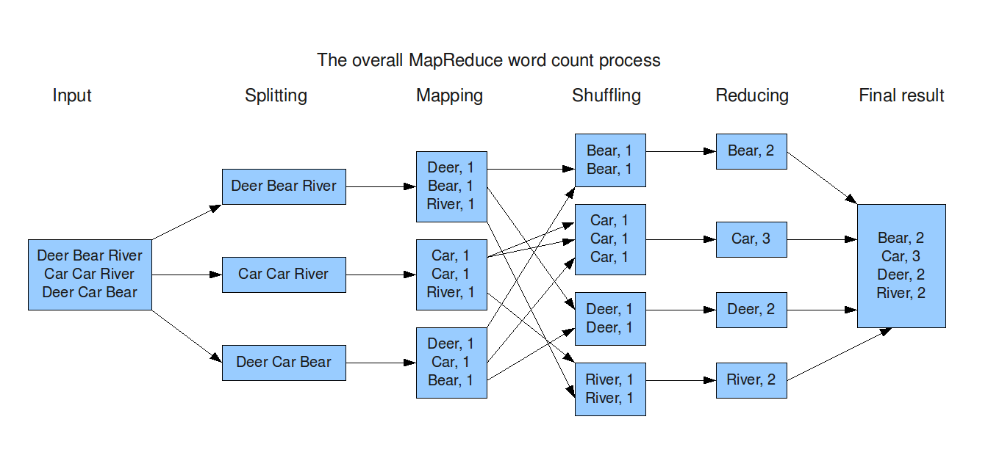
Word Count Dataflow

Slide 44
Word Count Using MapReduce
map(key, value):
// key: document name; value: text of the document
for each word w in value:
emit(w, 1)
reduce(key, values):
// key: a word; value: an iterator over counts
result = 0
for each count v in values:
result += v
emit(key, result)

Slide 45
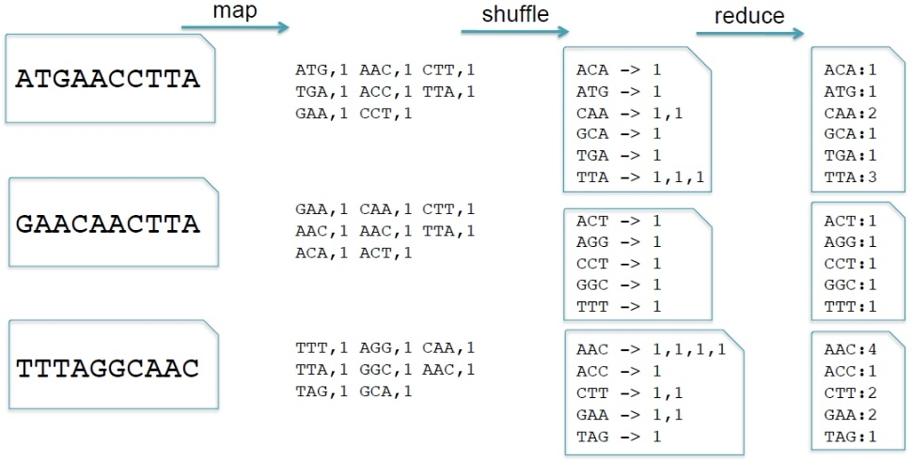
Codon Counting with MapReduce
Application developers focus on 2 (+1 internal) functions
Map: input -> key, value pairs
Shuffle: Group together pairs with same key
Reduce: key, value-lists -> output

Slide 46
Example: Language Model
Statistical machine translation:
Need to count number of times every 5-word sequence occurs in a large corpus of documents
Easy with MapReduce:
Map:
Extract (5-word sequence, count) from document
Reduce:
Combine the counts

Slide 47
Example: Language model
Statistical machine translation:
Need to count number of times every 5-word sequence occurs in a large corpus of documents
Easy with MapReduce:
Map:
Extract (5-word sequence, count) from document
Reduce:
Combine the counts

Slide 48
Example: Host size
Suppose we have a large web corpus
Look at the metadata file
Lines of the form: (URL, size, date, …)
For each host, find the total number of bytes
That is, the sum of the page sizes for all URLs from that particular host

Slide 49
Example: Join By Map-Reduce
Compute the natural join R(A,B) ⋈ S(B,C)
R and S are each stored in files
Tuples are pairs (a,b) or (b,c)
A | B
a₁ | b₁
a₂ | b₁
a₃ | b₂
a₄ | b₃
B | C
b₂ | c₁
b₂ | c₂
b₃ | c₃
A | C
a₃ | c₁
a₃ | c₂
a₄ | c₃
⋈
=
S
R

Slide 50
Map-Reduce Join
A Map process turns:
Each input tuple R(a,b) into key-value pair (b,(a,R))
Each input tuple S(b,c) into (b,(c,S))
Map processes send each key-value pair with key b to Reduce process h(b)
Hadoop does this automatically; just tell it what k is.
Each Reduce process matches all the pairs (b,(a,R)) with all (b,(c,S)) and outputs (a,b,c).

